Slide 2

Bird Shaman
Cape Dorset
Bird Shaman
Toonoo Sharky
gk }nr

Slide 3
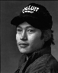
Bird Shaman
Toonoo Sharky, b. 1970
gk }nr
1995, Stone Cape Dorset, Cape Dorset Gift of Dr. Harry Winrob, 2006-516

Slide 4
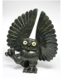

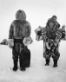
Bird Shaman
Exhibition
Toonoo Sharky, b. 1970
Community
gk }nr
REMOVED
1995, Stone Cape Dorset, Cape Dorset Gift of Dr. Harry Winrob, 2006-516

Slide 5
Bird Shaman
Exhibition
Toonoo Sharky, b. 1970
gk }nr
1995, Stone Cape Dorset, Cape Dorset Gift of Dr. Harry Winrob, 2006-516

Slide 6


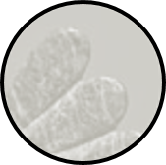
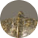
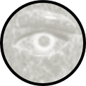
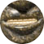
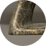
Bird Shaman
Toonoo Sharky, b. 1970
gk }nr
1995, Stone Cape Dorset, Cape Dorset Gift of Dr. Harry Winrob, 2006-516

Slide 7
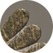
Bird Shaman
Toonoo Sharky, b. 1970
gk }nr
Shamanism among Eskimo peoples refers to those aspects of the Eskimo cultures that are related to the shamans’ role as a mediator between people and spirits, souls, and mythological beings. Such beliefs and practices were once widespread among Eskimo groups, but today are rarely practised.
1995, Stone Cape Dorset, Cape Dorset Gift of Dr. Harry Winrob, 2006-516

Slide 8
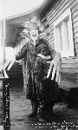
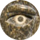
Bird Shaman
Toonoo Sharky, b. 1970
gk }nr
Shamanism among Eskimo peoples refers to those aspects of the Eskimo cultures that are related to the shamans’ role as a mediator between people and spirits, souls, and mythological beings. Such beliefs and practices were once widespread among Eskimo groups, but today are rarely practised.
1995, Stone Cape Dorset, Cape Dorset Gift of Dr. Harry Winrob, 2006-516

Slide 9
Bird Shaman
Toonoo Sharky, b. 1970
gk }nr
Shamanism among Eskimo peoples refers to those aspects of the Eskimo cultures that are related to the shamans’ role as a mediator between people and spirits, souls, and mythological beings. Such beliefs and practices were once widespread among Eskimo groups, but today are rarely practised.
Shamanism among Eskimo peoples refers to those aspects of the Eskimo cultures that are related to the shamans’ role as a mediator between people and spirits, souls, and mythological beings. Such beliefs and practices were once widespread among Eskimo groups, but today are rarely practised.
1995, Stone Cape Dorset, Cape Dorset Gift of Dr. Harry Winrob, 2006-516

Slide 10


Bird Shaman
Toonoo Sharky, b. 1970
gk }nr
Shamanism among Eskimo peoples refers to those aspects of the Eskimo cultures that are related to the shamans’ role as a mediator between people and spirits, souls, and mythological beings. Such beliefs and practices were once widespread among Eskimo groups, but today are rarely practiced.
Shamanism among Eskimo peoples refers to those aspects of the Eskimo cultures that are related to the shamans’ role as a mediator between people and spirits, souls, and mythological beings. Such beliefs and practices were once widespread among Eskimo groups, but today are rarely practiced.
1995, Stone Cape Dorset, Cape Dorset Gift of Dr. Harry Winrob, 2006-516

Slide 11
Bird Shaman
Toonoo Sharky, b. 1970
gk }nr
1995, Stone Cape Dorset, Cape Dorset Gift of Dr. Harry Winrob, 2006-516

Slide 12
Bird Shaman
Exhibition
Toonoo Sharky, b. 1970
gk }nr
1995, Stone Cape Dorset, Cape Dorset Gift of Dr. Harry Winrob, 2006-516

Slide 13
Bird Shaman
Exhibition
Toonoo Sharky, b. 1970
gk }nr
1995, Stone Cape Dorset, Cape Dorset Gift of Dr. Harry Winrob, 2006-516

Slide 14
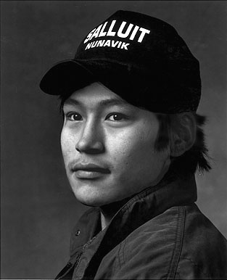

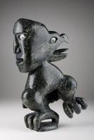
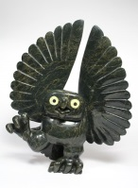
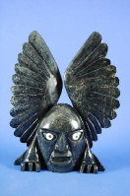
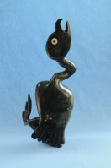
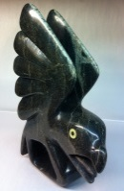
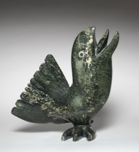
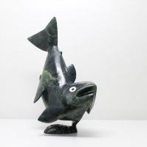
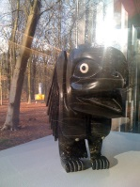
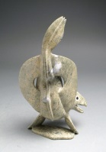
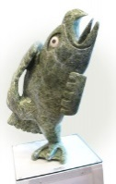
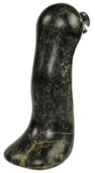
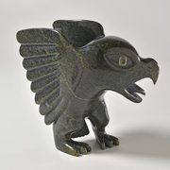
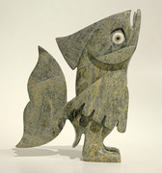
Toonoo Sharky, 1970
Cape Dorset, CA
Bird Shaman
Toonoo Sharky began carving at age nine, taught by his grandfather. His favourite subjects are “birds, and anything with wings.” But asked if he observed birds in nature, he replies: “Not often. You can look at them or work from your imagination. I don’t observe them; it is all from my head.” Toonoo’s visual statement is more emblematic than truly representative of the transformation process. For younger generations of Inuit, the imagining of shamanism and its various attributes has to a large extent supplanted actual knowledge of and belief in it.
Toonoo Sharky, b. 1970
gk }nr
1995, Stone Cape Dorset, Cape Dorset Gift of Dr. Harry Winrob, 2006-516

Slide 15
Toonoo Sharky, 1970
Cape Dorset, CA
Bird Shaman
Toonoo Sharky began carving at age nine, taught by his grandfather. His favourite subjects are “birds, and anything with wings.” But asked if he observed birds in nature, he replies: “Not often. You can look at them or work from your imagination. I don’t observe them; it is all from my head.” Toonoo’s visual statement is more emblematic than truly representative of the transformation process. For younger generations of Inuit, the imagining of shamanism and its various attributes has to a large extent supplanted actual knowledge of and belief in it.
Toonoo Sharky, b. 1970
gk }nr
1995, Stone Cape Dorset, Cape Dorset Gift of Dr. Harry Winrob, 2006-516

Slide 16
Toonoo Sharky, 1970
Cape Dorset, CA
Bird Shaman
Toonoo Sharky began carving at age nine, taught by his grandfather. His favourite subjects are “birds, and anything with wings.” But asked if he observed birds in nature, he replies: “Not often. You can look at them or work from your imagination. I don’t observe them; it is all from my head.” Toonoo’s visual statement is more emblematic than truly representative of the transformation process. For younger generations of Inuit, the imagining of shamanism and its various attributes has to a large extent supplanted actual knowledge of and belief in it.
Toonoo Sharky, b. 1970
gk }nr
1995, Stone Cape Dorset, Cape Dorset Gift of Dr. Harry Winrob, 2006-516

Slide 17
Toonoo Sharky, 1970
Cape Dorset, CA
Bird Shaman
Toonoo Sharky began carving at age nine, taught by his grandfather. His favourite subjects are “birds, and anything with wings.” But asked if he observed birds in nature, he replies: “Not often. You can look at them or work from your imagination. I don’t observe them; it is all from my head.” Toonoo’s visual statement is more emblematic than truly representative of the transformation process. For younger generations of Inuit, the imagining of shamanism and its various attributes has to a large extent supplanted actual knowledge of and belief in it.
Toonoo Sharky, b. 1970
gk }nr
1995, Stone Cape Dorset, Cape Dorset Gift of Dr. Harry Winrob, 2006-516

Slide 18
Toonoo Sharky, 1970
Cape Dorset, CA
Bird Shaman
Toonoo Sharky began carving at age nine, taught by his grandfather. His favourite subjects are “birds, and anything with wings.” But asked if he observed birds in nature, he replies: “Not often. You can look at them or work from your imagination. I don’t observe them; it is all from my head.” Toonoo’s visual statement is more emblematic than truly representative of the transformation process. For younger generations of Inuit, the imagining of shamanism and its various attributes has to a large extent supplanted actual knowledge of and belief in it.
Toonoo Sharky, b. 1970
gk }nr
1995, Stone Cape Dorset, Cape Dorset Gift of Dr. Harry Winrob, 2006-516

Slide 19
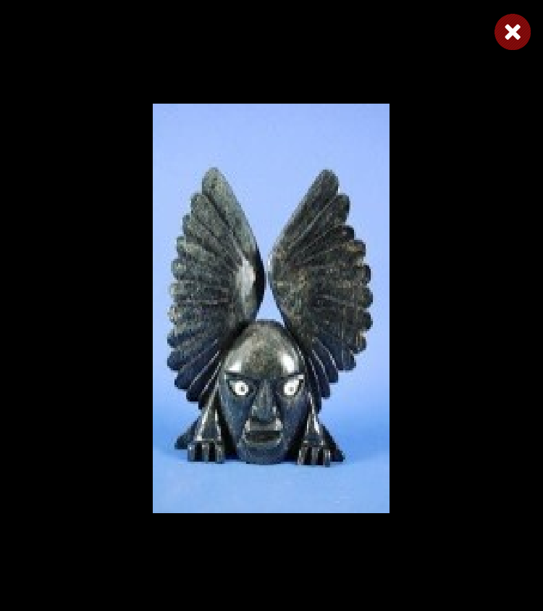
Toonoo Sharky, 1970
Cape Dorset, CA
Bird Shaman
Toonoo Sharky began carving at age nine, taught by his grandfather. His favourite subjects are “birds, and anything with wings.” But asked if he observed birds in nature, he replies: “Not often. You can look at them or work from your imagination. I don’t observe them; it is all from my head.” Toonoo’s visual statement is more emblematic than truly representative of the transformation process. For younger generations of Inuit, the imagining of shamanism and its various attributes has to a large extent supplanted actual knowledge of and belief in it.
Toonoo Sharky, b. 1970
gk }nr
1995, Stone Cape Dorset, Cape Dorset Gift of Dr. Harry Winrob, 2006-516

Slide 20
Toonoo Sharky, 1970
Cape Dorset, CA
Bird Shaman
Toonoo Sharky began carving at age nine, taught by his grandfather. His favourite subjects are “birds, and anything with wings.” But asked if he observed birds in nature, he replies: “Not often. You can look at them or work from your imagination. I don’t observe them; it is all from my head.” Toonoo’s visual statement is more emblematic than truly representative of the transformation process. For younger generations of Inuit, the imagining of shamanism and its various attributes has to a large extent supplanted actual knowledge of and belief in it.
Toonoo Sharky, b. 1970
gk }nr
1995, Stone Cape Dorset, Cape Dorset Gift of Dr. Harry Winrob, 2006-516

Slide 21
Toonoo Sharky, 1970
Cape Dorset, CA
Bird Shaman
Toonoo Sharky began carving at age nine, taught by his grandfather. His favourite subjects are “birds, and anything with wings.” But asked if he observed birds in nature, he replies: “Not often. You can look at them or work from your imagination. I don’t observe them; it is all from my head.” Toonoo’s visual statement is more emblematic than truly representative of the transformation process. For younger generations of Inuit, the imagining of shamanism and its various attributes has to a large extent supplanted actual knowledge of and belief in it.
Toonoo Sharky, b. 1970
gk }nr
1995, Stone Cape Dorset, Cape Dorset Gift of Dr. Harry Winrob, 2006-516

Slide 22
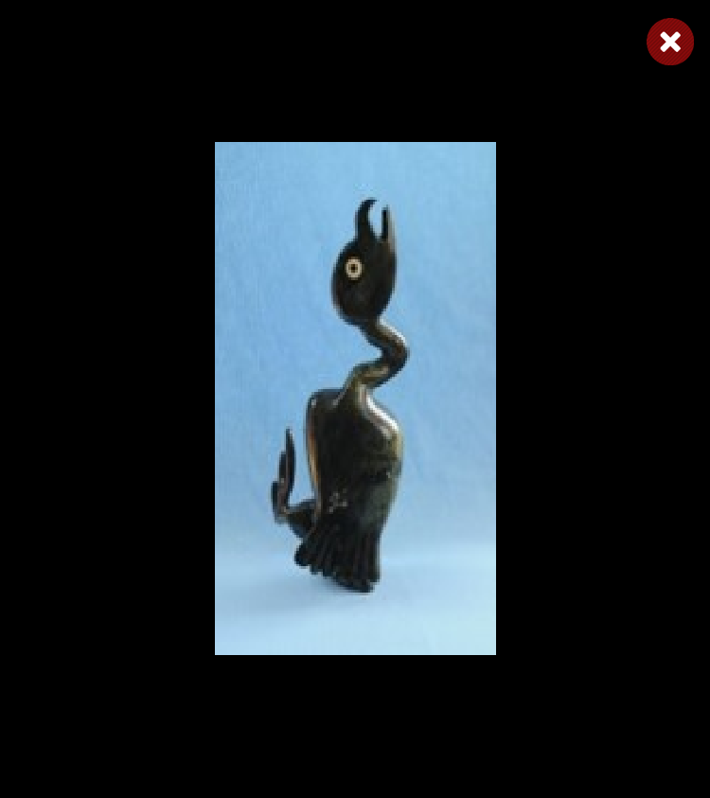
Toonoo Sharky, 1970
Cape Dorset, CA
Bird Shaman
Toonoo Sharky began carving at age nine, taught by his grandfather. His favourite subjects are “birds, and anything with wings.” But asked if he observed birds in nature, he replies: “Not often. You can look at them or work from your imagination. I don’t observe them; it is all from my head.” Toonoo’s visual statement is more emblematic than truly representative of the transformation process. For younger generations of Inuit, the imagining of shamanism and its various attributes has to a large extent supplanted actual knowledge of and belief in it.
Toonoo Sharky, b. 1970
gk }nr
1995, Stone Cape Dorset, Cape Dorset Gift of Dr. Harry Winrob, 2006-516

Slide 23
Toonoo Sharky, 1970
Cape Dorset, CA
Bird Shaman
Toonoo Sharky began carving at age nine, taught by his grandfather. His favourite subjects are “birds, and anything with wings.” But asked if he observed birds in nature, he replies: “Not often. You can look at them or work from your imagination. I don’t observe them; it is all from my head.” Toonoo’s visual statement is more emblematic than truly representative of the transformation process. For younger generations of Inuit, the imagining of shamanism and its various attributes has to a large extent supplanted actual knowledge of and belief in it.
Toonoo Sharky, b. 1970
gk }nr
1995, Stone Cape Dorset, Cape Dorset Gift of Dr. Harry Winrob, 2006-516

Slide 24
Toonoo Sharky, 1970
Cape Dorset, CA
Bird Shaman
Toonoo Sharky began carving at age nine, taught by his grandfather. His favourite subjects are “birds, and anything with wings.” But asked if he observed birds in nature, he replies: “Not often. You can look at them or work from your imagination. I don’t observe them; it is all from my head.” Toonoo’s visual statement is more emblematic than truly representative of the transformation process. For younger generations of Inuit, the imagining of shamanism and its various attributes has to a large extent supplanted actual knowledge of and belief in it.
Toonoo Sharky, b. 1970
gk }nr
1995, Stone Cape Dorset, Cape Dorset Gift of Dr. Harry Winrob, 2006-516

Slide 25

Toonoo Sharky, 1970
Cape Dorset, CA
Bird Shaman
Toonoo Sharky began carving at age nine, taught by his grandfather. His favourite subjects are “birds, and anything with wings.” But asked if he observed birds in nature, he replies: “Not often. You can look at them or work from your imagination. I don’t observe them; it is all from my head.” Toonoo’s visual statement is more emblematic than truly representative of the transformation process. For younger generations of Inuit, the imagining of shamanism and its various attributes has to a large extent supplanted actual knowledge of and belief in it.
Toonoo Sharky, b. 1970
gk }nr
1995, Stone Cape Dorset, Cape Dorset Gift of Dr. Harry Winrob, 2006-516

Slide 26
Toonoo Sharky, 1970
Cape Dorset, CA
Bird Shaman
Toonoo Sharky began carving at age nine, taught by his grandfather. His favourite subjects are “birds, and anything with wings.” But asked if he observed birds in nature, he replies: “Not often. You can look at them or work from your imagination. I don’t observe them; it is all from my head.” Toonoo’s visual statement is more emblematic than truly representative of the transformation process. For younger generations of Inuit, the imagining of shamanism and its various attributes has to a large extent supplanted actual knowledge of and belief in it.
Toonoo Sharky, b. 1970
gk }nr
1995, Stone Cape Dorset, Cape Dorset Gift of Dr. Harry Winrob, 2006-516

Slide 27
Toonoo Sharky, 1970
Cape Dorset, CA
Bird Shaman
Toonoo Sharky began carving at age nine, taught by his grandfather. His favourite subjects are “birds, and anything with wings.” But asked if he observed birds in nature, he replies: “Not often. You can look at them or work from your imagination. I don’t observe them; it is all from my head.” Toonoo’s visual statement is more emblematic than truly representative of the transformation process. For younger generations of Inuit, the imagining of shamanism and its various attributes has to a large extent supplanted actual knowledge of and belief in it.
Toonoo Sharky, b. 1970
gk }nr
1995, Stone Cape Dorset, Cape Dorset Gift of Dr. Harry Winrob, 2006-516

Slide 28
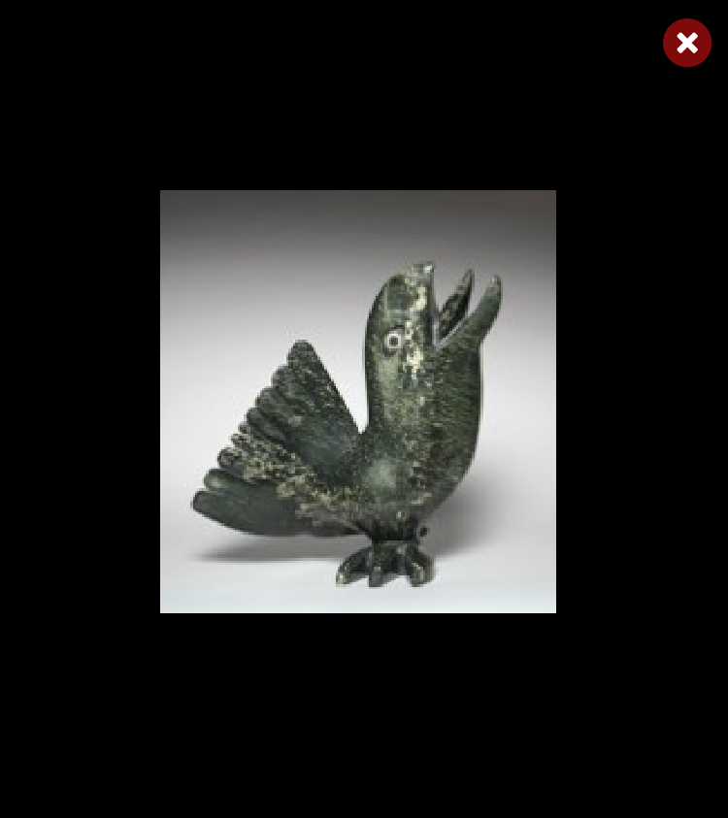
Toonoo Sharky, 1970
Cape Dorset, CA
Bird Shaman
Toonoo Sharky began carving at age nine, taught by his grandfather. His favourite subjects are “birds, and anything with wings.” But asked if he observed birds in nature, he replies: “Not often. You can look at them or work from your imagination. I don’t observe them; it is all from my head.” Toonoo’s visual statement is more emblematic than truly representative of the transformation process. For younger generations of Inuit, the imagining of shamanism and its various attributes has to a large extent supplanted actual knowledge of and belief in it.
Toonoo Sharky, b. 1970
gk }nr
1995, Stone Cape Dorset, Cape Dorset Gift of Dr. Harry Winrob, 2006-516

Slide 29
Toonoo Sharky, 1970
Cape Dorset, CA
Bird Shaman
Toonoo Sharky began carving at age nine, taught by his grandfather. His favourite subjects are “birds, and anything with wings.” But asked if he observed birds in nature, he replies: “Not often. You can look at them or work from your imagination. I don’t observe them; it is all from my head.” Toonoo’s visual statement is more emblematic than truly representative of the transformation process. For younger generations of Inuit, the imagining of shamanism and its various attributes has to a large extent supplanted actual knowledge of and belief in it.
Toonoo Sharky, b. 1970
gk }nr
1995, Stone Cape Dorset, Cape Dorset Gift of Dr. Harry Winrob, 2006-516

Slide 30
Toonoo Sharky, 1970
Cape Dorset, CA
Bird Shaman
Toonoo Sharky began carving at age nine, taught by his grandfather. His favourite subjects are “birds, and anything with wings.” But asked if he observed birds in nature, he replies: “Not often. You can look at them or work from your imagination. I don’t observe them; it is all from my head.” Toonoo’s visual statement is more emblematic than truly representative of the transformation process. For younger generations of Inuit, the imagining of shamanism and its various attributes has to a large extent supplanted actual knowledge of and belief in it.
Toonoo Sharky, b. 1970
gk }nr
1995, Stone Cape Dorset, Cape Dorset Gift of Dr. Harry Winrob, 2006-516

Slide 31
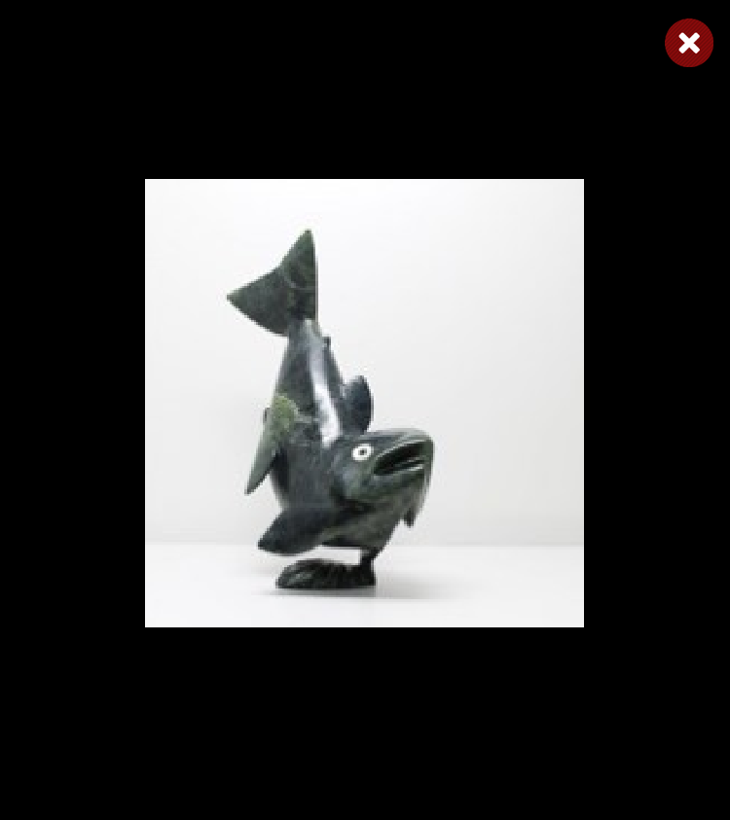
Toonoo Sharky, 1970
Cape Dorset, CA
Bird Shaman
Toonoo Sharky began carving at age nine, taught by his grandfather. His favourite subjects are “birds, and anything with wings.” But asked if he observed birds in nature, he replies: “Not often. You can look at them or work from your imagination. I don’t observe them; it is all from my head.” Toonoo’s visual statement is more emblematic than truly representative of the transformation process. For younger generations of Inuit, the imagining of shamanism and its various attributes has to a large extent supplanted actual knowledge of and belief in it.
Toonoo Sharky, b. 1970
gk }nr
1995, Stone Cape Dorset, Cape Dorset Gift of Dr. Harry Winrob, 2006-516

Slide 32
Toonoo Sharky, 1970
Cape Dorset, CA
Bird Shaman
Toonoo Sharky began carving at age nine, taught by his grandfather. His favourite subjects are “birds, and anything with wings.” But asked if he observed birds in nature, he replies: “Not often. You can look at them or work from your imagination. I don’t observe them; it is all from my head.” Toonoo’s visual statement is more emblematic than truly representative of the transformation process. For younger generations of Inuit, the imagining of shamanism and its various attributes has to a large extent supplanted actual knowledge of and belief in it.
Toonoo Sharky, b. 1970
gk }nr
1995, Stone Cape Dorset, Cape Dorset Gift of Dr. Harry Winrob, 2006-516

Slide 33
Toonoo Sharky, 1970
Cape Dorset, CA
Bird Shaman
Toonoo Sharky began carving at age nine, taught by his grandfather. His favourite subjects are “birds, and anything with wings.” But asked if he observed birds in nature, he replies: “Not often. You can look at them or work from your imagination. I don’t observe them; it is all from my head.” Toonoo’s visual statement is more emblematic than truly representative of the transformation process. For younger generations of Inuit, the imagining of shamanism and its various attributes has to a large extent supplanted actual knowledge of and belief in it.
Toonoo Sharky, b. 1970
gk }nr
1995, Stone Cape Dorset, Cape Dorset Gift of Dr. Harry Winrob, 2006-516

Slide 34
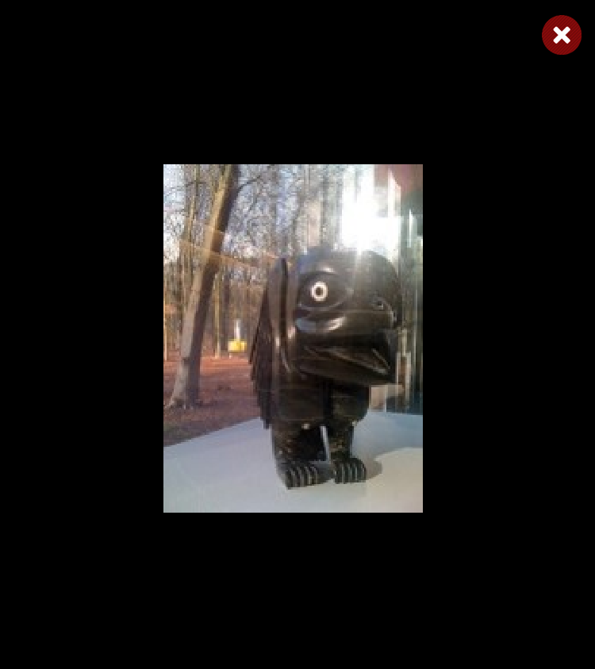
Toonoo Sharky, 1970
Cape Dorset, CA
Bird Shaman
Toonoo Sharky began carving at age nine, taught by his grandfather. His favourite subjects are “birds, and anything with wings.” But asked if he observed birds in nature, he replies: “Not often. You can look at them or work from your imagination. I don’t observe them; it is all from my head.” Toonoo’s visual statement is more emblematic than truly representative of the transformation process. For younger generations of Inuit, the imagining of shamanism and its various attributes has to a large extent supplanted actual knowledge of and belief in it.
Toonoo Sharky, b. 1970
gk }nr
1995, Stone Cape Dorset, Cape Dorset Gift of Dr. Harry Winrob, 2006-516

Slide 35
Toonoo Sharky, 1970
Cape Dorset, CA
Bird Shaman
Toonoo Sharky began carving at age nine, taught by his grandfather. His favourite subjects are “birds, and anything with wings.” But asked if he observed birds in nature, he replies: “Not often. You can look at them or work from your imagination. I don’t observe them; it is all from my head.” Toonoo’s visual statement is more emblematic than truly representative of the transformation process. For younger generations of Inuit, the imagining of shamanism and its various attributes has to a large extent supplanted actual knowledge of and belief in it.
Toonoo Sharky, b. 1970
gk }nr
1995, Stone Cape Dorset, Cape Dorset Gift of Dr. Harry Winrob, 2006-516

Slide 36
Toonoo Sharky, 1970
Cape Dorset, CA
Bird Shaman
Toonoo Sharky began carving at age nine, taught by his grandfather. His favourite subjects are “birds, and anything with wings.” But asked if he observed birds in nature, he replies: “Not often. You can look at them or work from your imagination. I don’t observe them; it is all from my head.” Toonoo’s visual statement is more emblematic than truly representative of the transformation process. For younger generations of Inuit, the imagining of shamanism and its various attributes has to a large extent supplanted actual knowledge of and belief in it.
Toonoo Sharky, b. 1970
gk }nr
1995, Stone Cape Dorset, Cape Dorset Gift of Dr. Harry Winrob, 2006-516

Slide 37
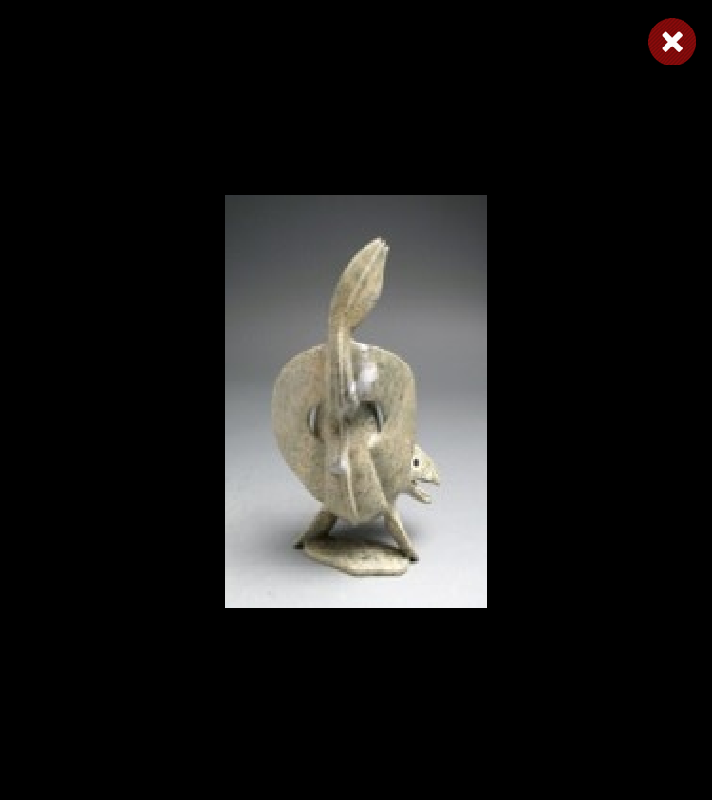
Toonoo Sharky, 1970
Cape Dorset, CA
Bird Shaman
Toonoo Sharky began carving at age nine, taught by his grandfather. His favourite subjects are “birds, and anything with wings.” But asked if he observed birds in nature, he replies: “Not often. You can look at them or work from your imagination. I don’t observe them; it is all from my head.” Toonoo’s visual statement is more emblematic than truly representative of the transformation process. For younger generations of Inuit, the imagining of shamanism and its various attributes has to a large extent supplanted actual knowledge of and belief in it.
Toonoo Sharky, b. 1970
gk }nr
1995, Stone Cape Dorset, Cape Dorset Gift of Dr. Harry Winrob, 2006-516

Slide 38
Toonoo Sharky, 1970
Cape Dorset, CA
Bird Shaman
Toonoo Sharky began carving at age nine, taught by his grandfather. His favourite subjects are “birds, and anything with wings.” But asked if he observed birds in nature, he replies: “Not often. You can look at them or work from your imagination. I don’t observe them; it is all from my head.” Toonoo’s visual statement is more emblematic than truly representative of the transformation process. For younger generations of Inuit, the imagining of shamanism and its various attributes has to a large extent supplanted actual knowledge of and belief in it.
Toonoo Sharky, b. 1970
gk }nr
1995, Stone Cape Dorset, Cape Dorset Gift of Dr. Harry Winrob, 2006-516

Slide 39
Toonoo Sharky, 1970
Cape Dorset, CA
Bird Shaman
Toonoo Sharky began carving at age nine, taught by his grandfather. His favourite subjects are “birds, and anything with wings.” But asked if he observed birds in nature, he replies: “Not often. You can look at them or work from your imagination. I don’t observe them; it is all from my head.” Toonoo’s visual statement is more emblematic than truly representative of the transformation process. For younger generations of Inuit, the imagining of shamanism and its various attributes has to a large extent supplanted actual knowledge of and belief in it.
Toonoo Sharky, b. 1970
gk }nr
1995, Stone Cape Dorset, Cape Dorset Gift of Dr. Harry Winrob, 2006-516

Slide 40
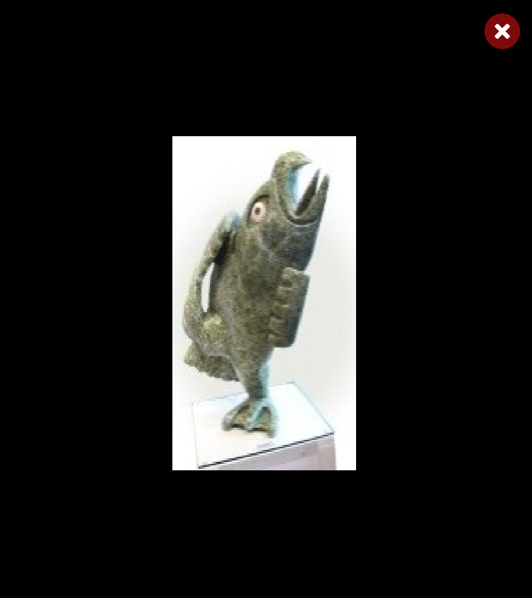
Toonoo Sharky, 1970
Cape Dorset, CA
Bird Shaman
Toonoo Sharky began carving at age nine, taught by his grandfather. His favourite subjects are “birds, and anything with wings.” But asked if he observed birds in nature, he replies: “Not often. You can look at them or work from your imagination. I don’t observe them; it is all from my head.” Toonoo’s visual statement is more emblematic than truly representative of the transformation process. For younger generations of Inuit, the imagining of shamanism and its various attributes has to a large extent supplanted actual knowledge of and belief in it.
Toonoo Sharky, b. 1970
gk }nr
1995, Stone Cape Dorset, Cape Dorset Gift of Dr. Harry Winrob, 2006-516

Slide 41
Toonoo Sharky, 1970
Cape Dorset, CA
Bird Shaman
Toonoo Sharky began carving at age nine, taught by his grandfather. His favourite subjects are “birds, and anything with wings.” But asked if he observed birds in nature, he replies: “Not often. You can look at them or work from your imagination. I don’t observe them; it is all from my head.” Toonoo’s visual statement is more emblematic than truly representative of the transformation process. For younger generations of Inuit, the imagining of shamanism and its various attributes has to a large extent supplanted actual knowledge of and belief in it.
Toonoo Sharky, b. 1970
gk }nr
1995, Stone Cape Dorset, Cape Dorset Gift of Dr. Harry Winrob, 2006-516

Slide 42
Toonoo Sharky, 1970
Cape Dorset, CA
Bird Shaman
Toonoo Sharky began carving at age nine, taught by his grandfather. His favourite subjects are “birds, and anything with wings.” But asked if he observed birds in nature, he replies: “Not often. You can look at them or work from your imagination. I don’t observe them; it is all from my head.” Toonoo’s visual statement is more emblematic than truly representative of the transformation process. For younger generations of Inuit, the imagining of shamanism and its various attributes has to a large extent supplanted actual knowledge of and belief in it.
Toonoo Sharky, b. 1970
gk }nr
1995, Stone Cape Dorset, Cape Dorset Gift of Dr. Harry Winrob, 2006-516

Slide 43
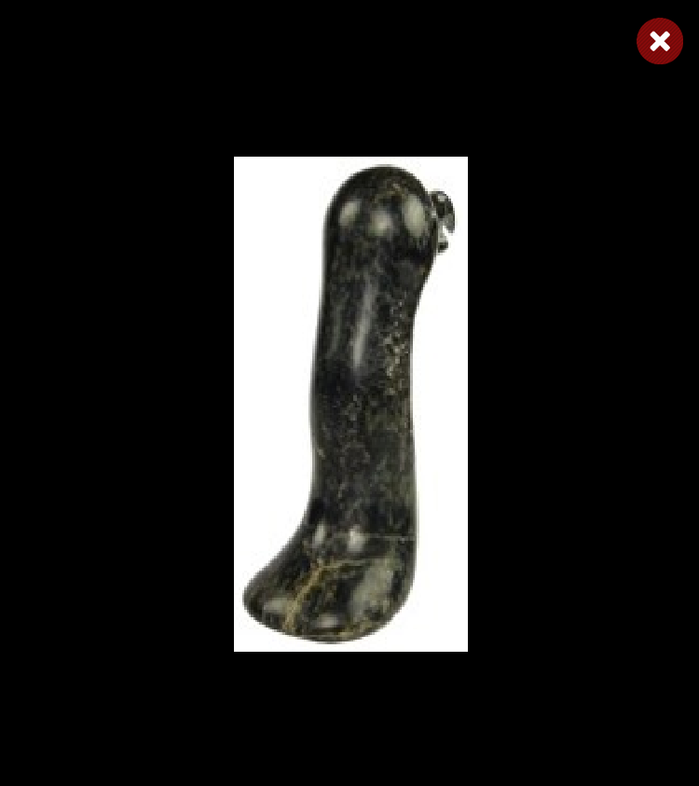
Toonoo Sharky, 1970
Cape Dorset, CA
Bird Shaman
Toonoo Sharky began carving at age nine, taught by his grandfather. His favourite subjects are “birds, and anything with wings.” But asked if he observed birds in nature, he replies: “Not often. You can look at them or work from your imagination. I don’t observe them; it is all from my head.” Toonoo’s visual statement is more emblematic than truly representative of the transformation process. For younger generations of Inuit, the imagining of shamanism and its various attributes has to a large extent supplanted actual knowledge of and belief in it.
Toonoo Sharky, b. 1970
gk }nr
1995, Stone Cape Dorset, Cape Dorset Gift of Dr. Harry Winrob, 2006-516

Slide 44
Toonoo Sharky, 1970
Cape Dorset, CA
Bird Shaman
Toonoo Sharky began carving at age nine, taught by his grandfather. His favourite subjects are “birds, and anything with wings.” But asked if he observed birds in nature, he replies: “Not often. You can look at them or work from your imagination. I don’t observe them; it is all from my head.” Toonoo’s visual statement is more emblematic than truly representative of the transformation process. For younger generations of Inuit, the imagining of shamanism and its various attributes has to a large extent supplanted actual knowledge of and belief in it.
Toonoo Sharky, b. 1970
gk }nr
1995, Stone Cape Dorset, Cape Dorset Gift of Dr. Harry Winrob, 2006-516

Slide 45
Toonoo Sharky, 1970
Cape Dorset, CA
Bird Shaman
Toonoo Sharky began carving at age nine, taught by his grandfather. His favourite subjects are “birds, and anything with wings.” But asked if he observed birds in nature, he replies: “Not often. You can look at them or work from your imagination. I don’t observe them; it is all from my head.” Toonoo’s visual statement is more emblematic than truly representative of the transformation process. For younger generations of Inuit, the imagining of shamanism and its various attributes has to a large extent supplanted actual knowledge of and belief in it.
Toonoo Sharky, b. 1970
gk }nr
1995, Stone Cape Dorset, Cape Dorset Gift of Dr. Harry Winrob, 2006-516

Slide 46
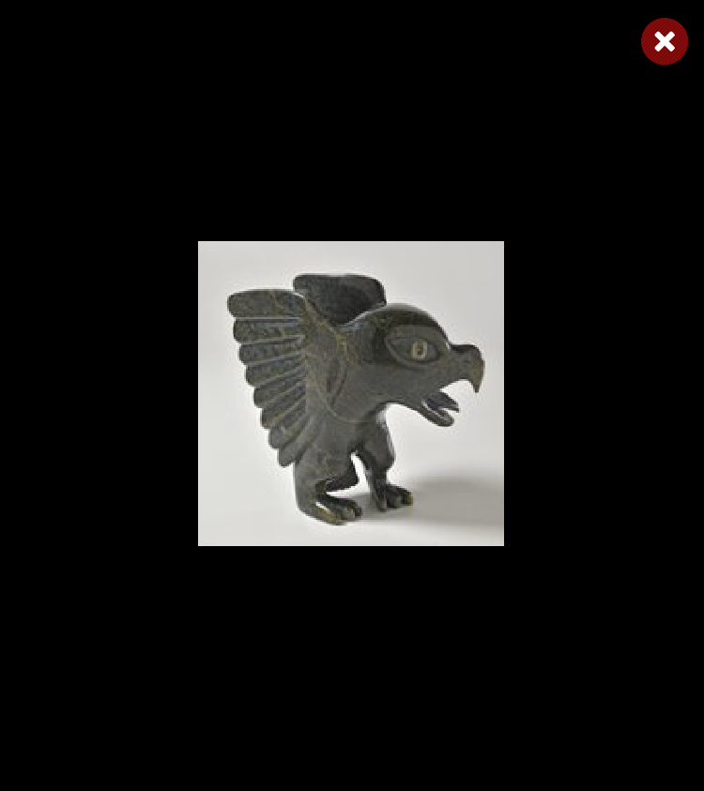
Toonoo Sharky, 1970
Cape Dorset, CA
Bird Shaman
Toonoo Sharky began carving at age nine, taught by his grandfather. His favourite subjects are “birds, and anything with wings.” But asked if he observed birds in nature, he replies: “Not often. You can look at them or work from your imagination. I don’t observe them; it is all from my head.” Toonoo’s visual statement is more emblematic than truly representative of the transformation process. For younger generations of Inuit, the imagining of shamanism and its various attributes has to a large extent supplanted actual knowledge of and belief in it.
Toonoo Sharky, b. 1970
gk }nr
1995, Stone Cape Dorset, Cape Dorset Gift of Dr. Harry Winrob, 2006-516

Slide 47
Toonoo Sharky, 1970
Cape Dorset, CA
Bird Shaman
Toonoo Sharky began carving at age nine, taught by his grandfather. His favourite subjects are “birds, and anything with wings.” But asked if he observed birds in nature, he replies: “Not often. You can look at them or work from your imagination. I don’t observe them; it is all from my head.” Toonoo’s visual statement is more emblematic than truly representative of the transformation process. For younger generations of Inuit, the imagining of shamanism and its various attributes has to a large extent supplanted actual knowledge of and belief in it.
Toonoo Sharky, b. 1970
gk }nr
1995, Stone Cape Dorset, Cape Dorset Gift of Dr. Harry Winrob, 2006-516

Slide 48
Toonoo Sharky, 1970
Cape Dorset, CA
Bird Shaman
Toonoo Sharky began carving at age nine, taught by his grandfather. His favourite subjects are “birds, and anything with wings.” But asked if he observed birds in nature, he replies: “Not often. You can look at them or work from your imagination. I don’t observe them; it is all from my head.” Toonoo’s visual statement is more emblematic than truly representative of the transformation process. For younger generations of Inuit, the imagining of shamanism and its various attributes has to a large extent supplanted actual knowledge of and belief in it.
Toonoo Sharky, b. 1970
gk }nr
1995, Stone Cape Dorset, Cape Dorset Gift of Dr. Harry Winrob, 2006-516

Slide 49
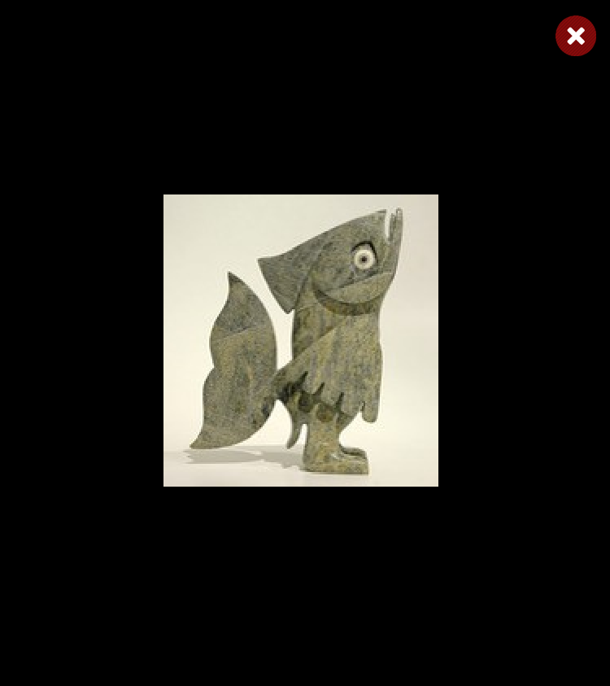
Toonoo Sharky, 1970
Cape Dorset, CA
Bird Shaman
Toonoo Sharky began carving at age nine, taught by his grandfather. His favourite subjects are “birds, and anything with wings.” But asked if he observed birds in nature, he replies: “Not often. You can look at them or work from your imagination. I don’t observe them; it is all from my head.” Toonoo’s visual statement is more emblematic than truly representative of the transformation process. For younger generations of Inuit, the imagining of shamanism and its various attributes has to a large extent supplanted actual knowledge of and belief in it.
Toonoo Sharky, b. 1970
gk }nr
1995, Stone Cape Dorset, Cape Dorset Gift of Dr. Harry Winrob, 2006-516

Slide 50
Toonoo Sharky, 1970
Cape Dorset, CA
Bird Shaman
Toonoo Sharky began carving at age nine, taught by his grandfather. His favourite subjects are “birds, and anything with wings.” But asked if he observed birds in nature, he replies: “Not often. You can look at them or work from your imagination. I don’t observe them; it is all from my head.” Toonoo’s visual statement is more emblematic than truly representative of the transformation process. For younger generations of Inuit, the imagining of shamanism and its various attributes has to a large extent supplanted actual knowledge of and belief in it.
Toonoo Sharky, b. 1970
gk }nr
1995, Stone Cape Dorset, Cape Dorset Gift of Dr. Harry Winrob, 2006-516

Slide 51
Bird Shaman
Exhibition
Toonoo Sharky, b. 1970
gk }nr
1995, Stone Cape Dorset, Cape Dorset Gift of Dr. Harry Winrob, 2006-516

Slide 52
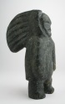
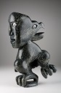

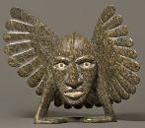
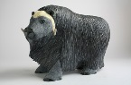
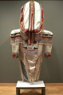

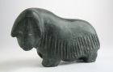
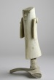
Bird Shaman
Shaman
Bird Spirits
Toonoo Sharky, b. 1970
gk }nr
Barnabus A.
Toonoo Sharky
Shaman
Steatite
Birds
Stone
Bird Shaman
Musk Ox
Toonoo Sharky
Barnabus A.
Birds
Stone
Ox
Stone
Amauti Dress
Preparing to Fly
Talerook, M.
Toonoo Sharky
Amauti
Fabric
Birds
Stone
Musk Ox
Arviat
1995, Stone Cape Dorset, Cape Dorset Gift of Dr. Harry Winrob, 2006-516
Lucassie I.
Anowtalik, L.
Ox
Antler
Antler

Slide 53
Bird Shaman
Shaman
Bird Spirits
Toonoo Sharky, b. 1970
gk }nr
Barnabus A.
Toonoo Sharky
Shaman
Steatite
Birds
Stone
Bird Shaman
Musk Ox
Toonoo Sharky
Barnabus A.
Birds
Stone
Ox
Stone
Amauti Dress
Preparing to Fly
Talerook, M.
Toonoo Sharky
Amauti
Fabric
Birds
Stone
Musk Ox
Arviat
1995, Stone Cape Dorset, Cape Dorset Gift of Dr. Harry Winrob, 2006-516
Lucassie I.
Anowtalik, L.
Ox
Antler
Antler

Slide 54
Bird Shaman
Shaman
Bird Spirits
Toonoo Sharky, b. 1970
gk }nr
Barnabus A.
Toonoo Sharky
Shaman
Steatite
Birds
Stone
Bird Shaman
Musk Ox
Toonoo Sharky
Barnabus A.
Birds
Stone
Ox
Stone
Amauti Dress
Preparing to Fly
Talerook, M.
Toonoo Sharky
Amauti
Fabric
Birds
Stone
Musk Ox
Arviat
1995, Stone Cape Dorset, Cape Dorset Gift of Dr. Harry Winrob, 2006-516
Lucassie I.
Anowtalik, L.
Ox
Antler
Antler

Slide 55
Bird Shaman
Shaman
Bird Spirits
Toonoo Sharky, b. 1970
gk }nr
Barnabus A.
Toonoo Sharky
Shaman
Steatite
Birds
Stone
Bird Shaman
Musk Ox
Toonoo Sharky
Barnabus A.
Birds
Stone
Ox
Stone
Amauti Dress
Preparing to Fly
Talerook, M.
Toonoo Sharky
Amauti
Fabric
Birds
Stone
Musk Ox
Arviat
1995, Stone Cape Dorset, Cape Dorset Gift of Dr. Harry Winrob, 2006-516
Lucassie I.
Anowtalik, L.
Ox
Antler
Antler

Slide 56
Bird Shaman
Shaman
Bird Spirits
Toonoo Sharky, b. 1970
gk }nr
Barnabus A.
Toonoo Sharky
Shaman
Steatite
Birds
Stone
Bird Shaman
Musk Ox
Toonoo Sharky
Barnabus A.
Birds
Stone
Ox
Stone
Amauti Dress
Preparing to Fly
Talerook, M.
Toonoo Sharky
Amauti
Fabric
Birds
Stone
Musk Ox
Arviat
1995, Stone Cape Dorset, Cape Dorset Gift of Dr. Harry Winrob, 2006-516
Lucassie I.
Anowtalik, L.
Ox
Antler
Antler

Slide 57
Bird Shaman
Shaman
Bird Spirits
Toonoo Sharky, b. 1970
gk }nr
Barnabus A.
Toonoo Sharky
Shaman
Steatite
Birds
Stone
Bird Shaman
Musk Ox
Toonoo Sharky
Barnabus A.
Birds
Stone
Ox
Stone
Amauti Dress
Preparing to Fly
Talerook, M.
Toonoo Sharky
Amauti
Fabric
Birds
Stone
Musk Ox
Arviat
1995, Stone Cape Dorset, Cape Dorset Gift of Dr. Harry Winrob, 2006-516
Lucassie I.
Anowtalik, L.
Ox
Antler
Antler

Slide 58
Bird Shaman
Shaman
Bird Spirits
Toonoo Sharky, b. 1970
gk }nr
Barnabus A.
Toonoo Sharky
Shaman
Steatite
Birds
Stone
Bird Shaman
Musk Ox
Toonoo Sharky
Barnabus A.
Birds
Stone
Ox
Stone
Amauti Dress
Preparing to Fly
Talerook, M.
Toonoo Sharky
Amauti
Fabric
Birds
Stone
Musk Ox
Arviat
1995, Stone Cape Dorset, Cape Dorset Gift of Dr. Harry Winrob, 2006-516
Lucassie I.
Anowtalik, L.
Ox
Antler
Antler

Slide 59
Bird Shaman
Shaman
Bird Spirits
Toonoo Sharky, b. 1970
gk }nr
Barnabus A.
Toonoo Sharky
Shaman
Steatite
Birds
Stone
Bird Shaman
Musk Ox
Toonoo Sharky
Barnabus A.
Birds
Stone
Ox
Stone
Amauti Dress
Preparing to Fly
Talerook, M.
Toonoo Sharky
Amauti
Fabric
Birds
Stone
Musk Ox
Arviat
1995, Stone Cape Dorset, Cape Dorset Gift of Dr. Harry Winrob, 2006-516
Lucassie I.
Anowtalik, L.
Ox
Antler
Antler

Slide 60
Bird Shaman
Shaman
Bird Spirits
Toonoo Sharky, b. 1970
gk }nr
Barnabus A.
Toonoo Sharky
Shaman
Steatite
Birds
Stone
Bird Shaman
Musk Ox
Toonoo Sharky
Barnabus A.
Birds
Stone
Ox
Stone
Amauti Dress
Preparing to Fly
Talerook, M.
Toonoo Sharky
Amauti
Fabric
Birds
Stone
Musk Ox
Arviat
1995, Stone Cape Dorset, Cape Dorset Gift of Dr. Harry Winrob, 2006-516
Lucassie I.
Anowtalik, L.
Ox
Antler
Antler

Slide 61
Bird Shaman
Shaman
Bird Spirits
Toonoo Sharky, b. 1970
gk }nr
Barnabus A.
Toonoo Sharky
Shaman
Steatite
Birds
Stone
Bird Shaman
Musk Ox
Toonoo Sharky
Barnabus A.
Birds
Stone
Ox
Stone
Amauti Dress
Preparing to Fly
Talerook, M.
Toonoo Sharky
Amauti
Fabric
Birds
Stone
Musk Ox
Arviat
1995, Stone Cape Dorset, Cape Dorset Gift of Dr. Harry Winrob, 2006-516
Lucassie I.
Anowtalik, L.
Ox
Antler
Antler

Slide 62
Bird Shaman
Shaman
Bird Spirits
Toonoo Sharky, b. 1970
gk }nr
Barnabus A.
Toonoo Sharky
Shaman
Steatite
Birds
Stone
Bird Shaman
Musk Ox
Toonoo Sharky
Barnabus A.
Birds
Stone
Ox
Stone
Amauti Dress
Preparing to Fly
Talerook, M.
Toonoo Sharky
Amauti
Fabric
Birds
Stone
Musk Ox
Arviat
1995, Stone Cape Dorset, Cape Dorset Gift of Dr. Harry Winrob, 2006-516
Lucassie I.
Anowtalik, L.
Ox
Antler
Antler

Slide 63
Bird Shaman
Shaman
Bird Spirits
Toonoo Sharky, b. 1970
gk }nr
Barnabus A.
Toonoo Sharky
Shaman
Steatite
Birds
Stone
Bird Shaman
Musk Ox
Toonoo Sharky
Barnabus A.
Birds
Stone
Ox
Stone
Amauti Dress
Preparing to Fly
Talerook, M.
Toonoo Sharky
Amauti
Fabric
Birds
Stone
Musk Ox
Arviat
1995, Stone Cape Dorset, Cape Dorset Gift of Dr. Harry Winrob, 2006-516
Lucassie I.
Anowtalik, L.
Ox
Antler
Antler

Slide 64
Bird Shaman
Shaman
Bird Spirits
Toonoo Sharky, b. 1970
gk }nr
Barnabus A.
Toonoo Sharky
Shaman
Steatite
Birds
Stone
Bird Shaman
Musk Ox
Toonoo Sharky
Barnabus A.
Birds
Stone
Ox
Stone
Amauti Dress
Preparing to Fly
Talerook, M.
Toonoo Sharky
Amauti
Fabric
Birds
Stone
Musk Ox
Arviat
1995, Stone Cape Dorset, Cape Dorset Gift of Dr. Harry Winrob, 2006-516
Lucassie I.
Anowtalik, L.
Ox
Antler
Antler

Slide 65
Bird Shaman
Shaman
Bird Spirits
Toonoo Sharky, b. 1970
gk }nr
Barnabus A.
Toonoo Sharky
Shaman
Steatite
Birds
Stone
Bird Shaman
Musk Ox
Toonoo Sharky
Barnabus A.
Birds
Stone
Ox
Stone
Amauti Dress
Preparing to Fly
Talerook, M.
Toonoo Sharky
Amauti
Fabric
Birds
Stone
Musk Ox
Arviat
1995, Stone Cape Dorset, Cape Dorset Gift of Dr. Harry Winrob, 2006-516
Lucassie I.
Anowtalik, L.
Ox
Antler
Antler

Slide 66
Bird Shaman
Shaman
Bird Spirits
Toonoo Sharky, b. 1970
gk }nr
Barnabus A.
Toonoo Sharky
Shaman
Steatite
Birds
Stone
Bird Shaman
Musk Ox
Toonoo Sharky
Barnabus A.
Birds
Stone
Ox
Stone
Amauti Dress
Preparing to Fly
Talerook, M.
Toonoo Sharky
Amauti
Fabric
Birds
Stone
Musk Ox
Arviat
1995, Stone Cape Dorset, Cape Dorset Gift of Dr. Harry Winrob, 2006-516
Lucassie I.
Anowtalik, L.
Ox
Antler
Antler

Slide 67
Bird Shaman
Shaman
Bird Spirits
Toonoo Sharky, b. 1970
gk }nr
Barnabus A.
Toonoo Sharky
Shaman
Steatite
Birds
Stone
Bird Shaman
Musk Ox
Toonoo Sharky
Barnabus A.
Birds
Stone
Ox
Stone
Amauti Dress
Preparing to Fly
Talerook, M.
Toonoo Sharky
Amauti
Fabric
Birds
Stone
Musk Ox
Arviat
1995, Stone Cape Dorset, Cape Dorset Gift of Dr. Harry Winrob, 2006-516
Lucassie I.
Anowtalik, L.
Ox
Antler
Antler

Slide 68
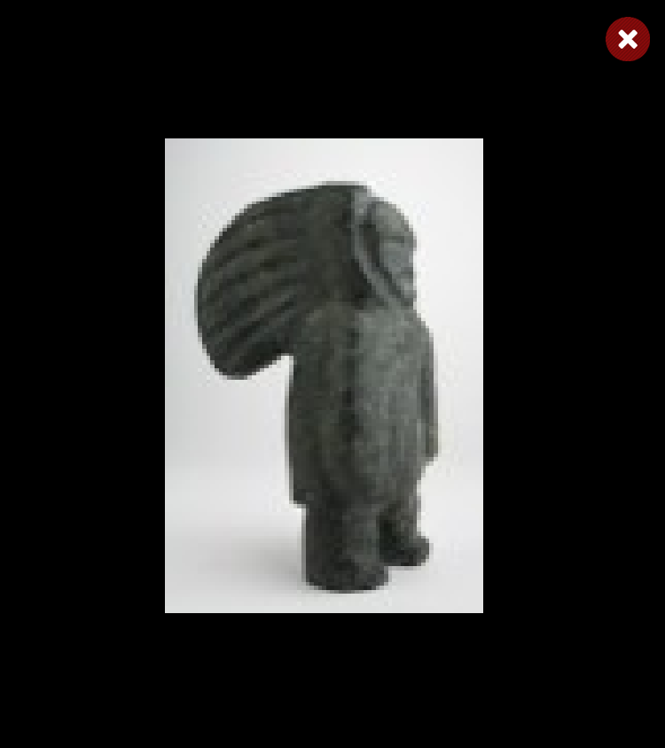
Bird Shaman
Shaman
Bird Spirits
Toonoo Sharky, b. 1970
gk }nr
Barnabus A.
Toonoo Sharky
Shaman
Steatite
Birds
Stone
Bird Shaman
Musk Ox
Toonoo Sharky
Barnabus A.
Birds
Stone
Ox
Stone
Amauti Dress
Preparing to Fly
Talerook, M.
Toonoo Sharky
Amauti
Fabric
Birds
Stone
Musk Ox
Arviat
1995, Stone Cape Dorset, Cape Dorset Gift of Dr. Harry Winrob, 2006-516
Lucassie I.
Anowtalik, L.
Ox
Antler
Antler

Slide 69
Bird Shaman
Shaman
Bird Spirits
Toonoo Sharky, b. 1970
gk }nr
Barnabus A.
Toonoo Sharky
Shaman
Steatite
Birds
Stone
Bird Shaman
Musk Ox
Toonoo Sharky
Barnabus A.
Birds
Stone
Ox
Stone
Amauti Dress
Preparing to Fly
Talerook, M.
Toonoo Sharky
Amauti
Fabric
Birds
Stone
Musk Ox
Arviat
1995, Stone Cape Dorset, Cape Dorset Gift of Dr. Harry Winrob, 2006-516
Lucassie I.
Anowtalik, L.
Ox
Antler
Antler

Slide 70
Bird Shaman
Shaman
Bird Spirits
Toonoo Sharky, b. 1970
gk }nr
Barnabus A.
Toonoo Sharky
Shaman
Steatite
Birds
Stone
Bird Shaman
Musk Ox
Toonoo Sharky
Barnabus A.
Birds
Stone
Ox
Stone
Amauti Dress
Preparing to Fly
Talerook, M.
Toonoo Sharky
Amauti
Fabric
Birds
Stone
Musk Ox
Arviat
1995, Stone Cape Dorset, Cape Dorset Gift of Dr. Harry Winrob, 2006-516
Lucassie I.
Anowtalik, L.
Ox
Antler
Antler

Slide 71
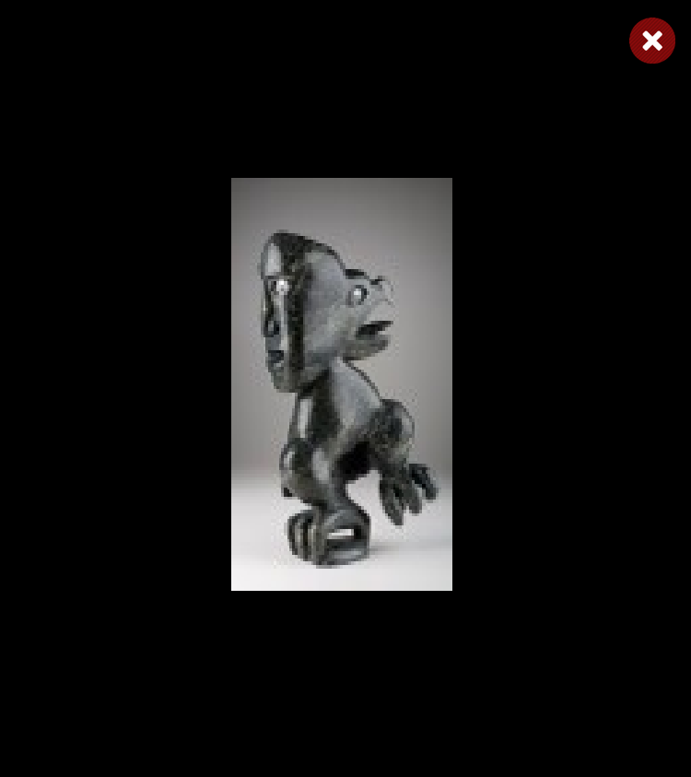
Bird Shaman
Shaman
Bird Spirits
Toonoo Sharky, b. 1970
gk }nr
Barnabus A.
Toonoo Sharky
Shaman
Steatite
Birds
Stone
Bird Shaman
Musk Ox
Toonoo Sharky
Barnabus A.
Birds
Stone
Ox
Stone
Amauti Dress
Preparing to Fly
Talerook, M.
Toonoo Sharky
Amauti
Fabric
Birds
Stone
Musk Ox
Arviat
1995, Stone Cape Dorset, Cape Dorset Gift of Dr. Harry Winrob, 2006-516
Lucassie I.
Anowtalik, L.
Ox
Antler
Antler

Slide 72
Bird Shaman
Shaman
Bird Spirits
Toonoo Sharky, b. 1970
gk }nr
Barnabus A.
Toonoo Sharky
Shaman
Steatite
Birds
Stone
Bird Shaman
Musk Ox
Toonoo Sharky
Barnabus A.
Birds
Stone
Ox
Stone
Amauti Dress
Preparing to Fly
Talerook, M.
Toonoo Sharky
Amauti
Fabric
Birds
Stone
Musk Ox
Arviat
1995, Stone Cape Dorset, Cape Dorset Gift of Dr. Harry Winrob, 2006-516
Lucassie I.
Anowtalik, L.
Ox
Antler
Antler

Slide 73
Bird Shaman
Shaman
Bird Spirits
Toonoo Sharky, b. 1970
gk }nr
Barnabus A.
Toonoo Sharky
Shaman
Steatite
Birds
Stone
Bird Shaman
Musk Ox
Toonoo Sharky
Barnabus A.
Birds
Stone
Ox
Stone
Amauti Dress
Preparing to Fly
Talerook, M.
Toonoo Sharky
Amauti
Fabric
Birds
Stone
Musk Ox
Arviat
1995, Stone Cape Dorset, Cape Dorset Gift of Dr. Harry Winrob, 2006-516
Lucassie I.
Anowtalik, L.
Ox
Antler
Antler

Slide 74
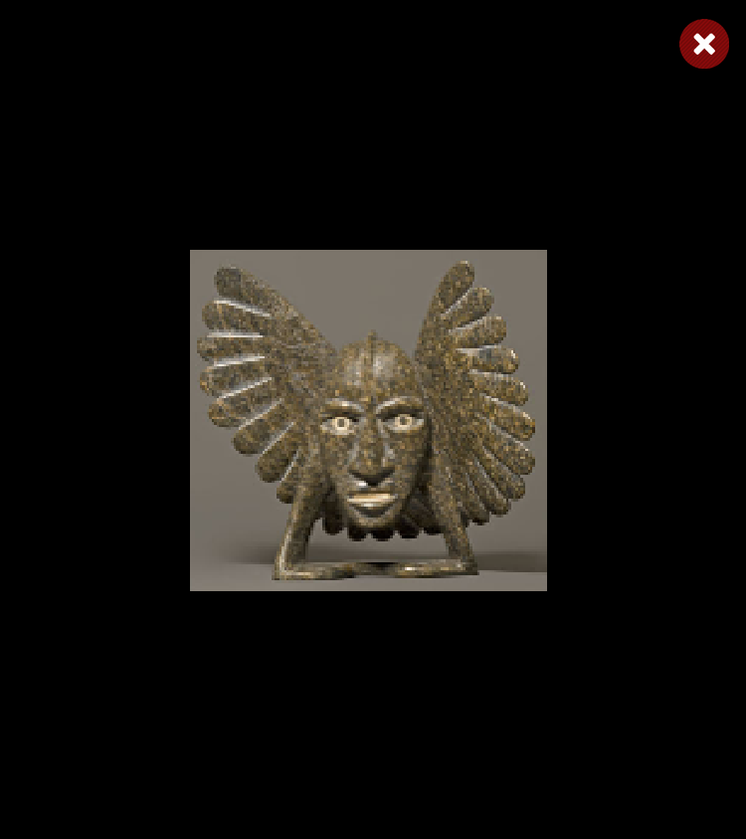
Bird Shaman
Shaman
Bird Spirits
Toonoo Sharky, b. 1970
gk }nr
Barnabus A.
Toonoo Sharky
Shaman
Steatite
Birds
Stone
Bird Shaman
Musk Ox
Toonoo Sharky
Barnabus A.
Birds
Stone
Ox
Stone
Amauti Dress
Preparing to Fly
Talerook, M.
Toonoo Sharky
Amauti
Fabric
Birds
Stone
Musk Ox
Arviat
1995, Stone Cape Dorset, Cape Dorset Gift of Dr. Harry Winrob, 2006-516
Lucassie I.
Anowtalik, L.
Ox
Antler
Antler

Slide 75
Bird Shaman
Shaman
Bird Spirits
Toonoo Sharky, b. 1970
gk }nr
Barnabus A.
Toonoo Sharky
Shaman
Steatite
Birds
Stone
Bird Shaman
Musk Ox
Toonoo Sharky
Barnabus A.
Birds
Stone
Ox
Stone
Amauti Dress
Preparing to Fly
Talerook, M.
Toonoo Sharky
Amauti
Fabric
Birds
Stone
Musk Ox
Arviat
1995, Stone Cape Dorset, Cape Dorset Gift of Dr. Harry Winrob, 2006-516
Lucassie I.
Anowtalik, L.
Ox
Antler
Antler

Slide 76
Bird Shaman
Shaman
Bird Spirits
Toonoo Sharky, b. 1970
gk }nr
Barnabus A.
Toonoo Sharky
Shaman
Steatite
Birds
Stone
Bird Shaman
Musk Ox
Toonoo Sharky
Barnabus A.
Birds
Stone
Ox
Stone
Amauti Dress
Preparing to Fly
Talerook, M.
Toonoo Sharky
Amauti
Fabric
Birds
Stone
Musk Ox
Arviat
1995, Stone Cape Dorset, Cape Dorset Gift of Dr. Harry Winrob, 2006-516
Lucassie I.
Anowtalik, L.
Ox
Antler
Antler

Slide 77
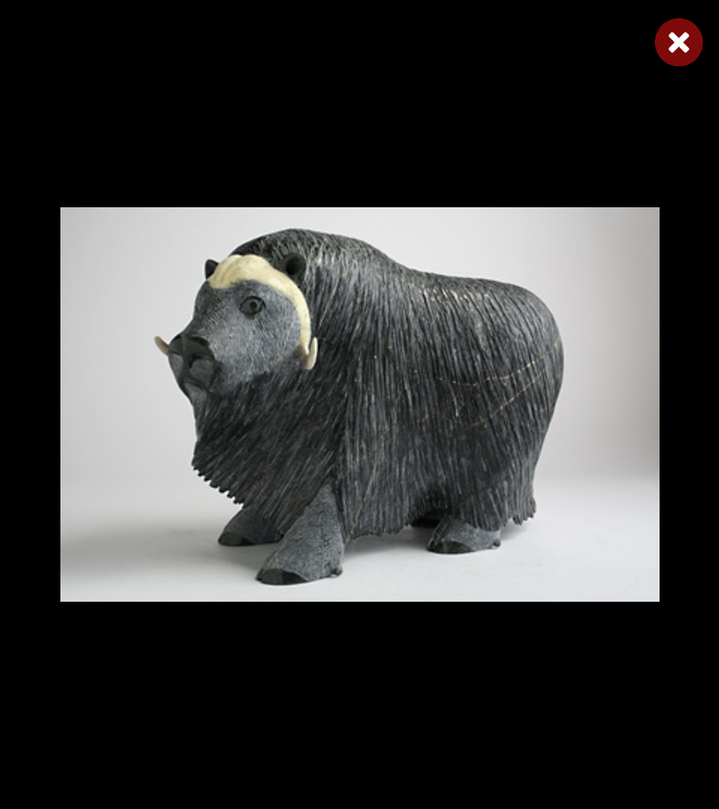
Bird Shaman
Shaman
Bird Spirits
Toonoo Sharky, b. 1970
gk }nr
Barnabus A.
Toonoo Sharky
Shaman
Steatite
Birds
Stone
Bird Shaman
Musk Ox
Toonoo Sharky
Barnabus A.
Birds
Stone
Ox
Stone
Amauti Dress
Preparing to Fly
Talerook, M.
Toonoo Sharky
Amauti
Fabric
Birds
Stone
Musk Ox
Arviat
1995, Stone Cape Dorset, Cape Dorset Gift of Dr. Harry Winrob, 2006-516
Lucassie I.
Anowtalik, L.
Ox
Antler
Antler

Slide 78
Bird Shaman
Shaman
Bird Spirits
Toonoo Sharky, b. 1970
gk }nr
Barnabus A.
Toonoo Sharky
Shaman
Steatite
Birds
Stone
Bird Shaman
Musk Ox
Toonoo Sharky
Barnabus A.
Birds
Stone
Ox
Stone
Amauti Dress
Preparing to Fly
Talerook, M.
Toonoo Sharky
Amauti
Fabric
Birds
Stone
Musk Ox
Arviat
1995, Stone Cape Dorset, Cape Dorset Gift of Dr. Harry Winrob, 2006-516
Lucassie I.
Anowtalik, L.
Ox
Antler
Antler

Slide 79
Bird Shaman
Shaman
Bird Spirits
Toonoo Sharky, b. 1970
gk }nr
Barnabus A.
Toonoo Sharky
Shaman
Steatite
Birds
Stone
Bird Shaman
Musk Ox
Toonoo Sharky
Barnabus A.
Birds
Stone
Ox
Stone
Amauti Dress
Preparing to Fly
Talerook, M.
Toonoo Sharky
Amauti
Fabric
Birds
Stone
Musk Ox
Arviat
1995, Stone Cape Dorset, Cape Dorset Gift of Dr. Harry Winrob, 2006-516
Lucassie I.
Anowtalik, L.
Ox
Antler
Antler

Slide 80
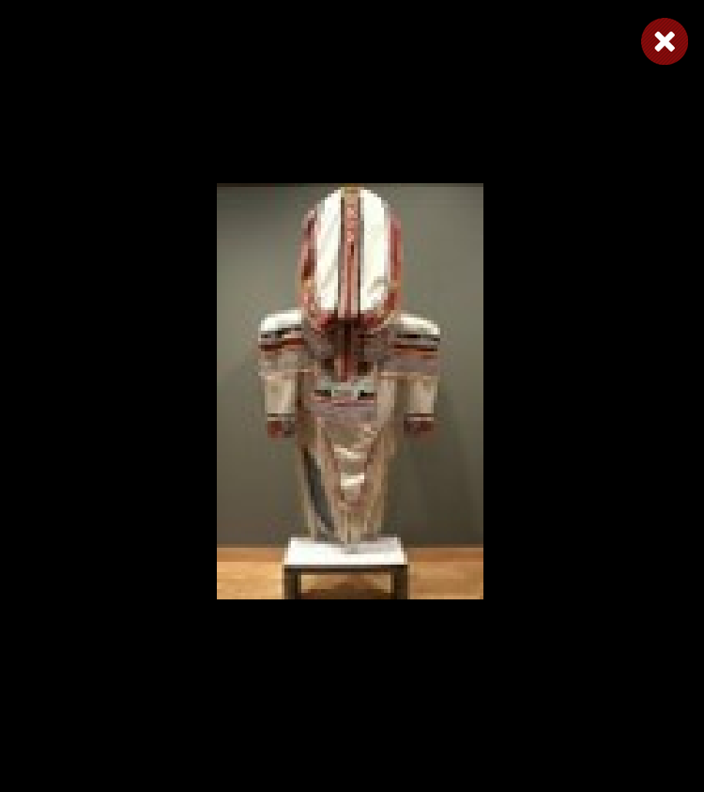
Bird Shaman
Shaman
Bird Spirits
Toonoo Sharky, b. 1970
gk }nr
Barnabus A.
Toonoo Sharky
Shaman
Steatite
Birds
Stone
Bird Shaman
Musk Ox
Toonoo Sharky
Barnabus A.
Birds
Stone
Ox
Stone
Amauti Dress
Preparing to Fly
Talerook, M.
Toonoo Sharky
Amauti
Fabric
Birds
Stone
Musk Ox
Arviat
1995, Stone Cape Dorset, Cape Dorset Gift of Dr. Harry Winrob, 2006-516
Lucassie I.
Anowtalik, L.
Ox
Antler
Antler

Slide 81
Bird Shaman
Shaman
Bird Spirits
Toonoo Sharky, b. 1970
gk }nr
Barnabus A.
Toonoo Sharky
Shaman
Steatite
Birds
Stone
Bird Shaman
Musk Ox
Toonoo Sharky
Barnabus A.
Birds
Stone
Ox
Stone
Amauti Dress
Preparing to Fly
Talerook, M.
Toonoo Sharky
Amauti
Fabric
Birds
Stone
Musk Ox
Arviat
1995, Stone Cape Dorset, Cape Dorset Gift of Dr. Harry Winrob, 2006-516
Lucassie I.
Anowtalik, L.
Ox
Antler
Antler

Slide 82
Bird Shaman
Shaman
Bird Spirits
Toonoo Sharky, b. 1970
gk }nr
Barnabus A.
Toonoo Sharky
Shaman
Steatite
Birds
Stone
Bird Shaman
Musk Ox
Toonoo Sharky
Barnabus A.
Birds
Stone
Ox
Stone
Amauti Dress
Preparing to Fly
Talerook, M.
Toonoo Sharky
Amauti
Fabric
Birds
Stone
Musk Ox
Arviat
1995, Stone Cape Dorset, Cape Dorset Gift of Dr. Harry Winrob, 2006-516
Lucassie I.
Anowtalik, L.
Ox
Antler
Antler

Slide 83
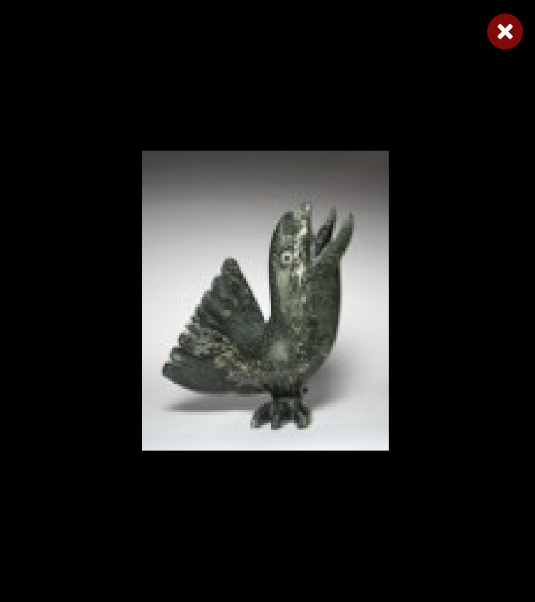
Bird Shaman
Shaman
Bird Spirits
Toonoo Sharky, b. 1970
gk }nr
Barnabus A.
Toonoo Sharky
Shaman
Steatite
Birds
Stone
Bird Shaman
Musk Ox
Toonoo Sharky
Barnabus A.
Birds
Stone
Ox
Stone
Amauti Dress
Preparing to Fly
Talerook, M.
Toonoo Sharky
Amauti
Fabric
Birds
Stone
Musk Ox
Arviat
1995, Stone Cape Dorset, Cape Dorset Gift of Dr. Harry Winrob, 2006-516
Lucassie I.
Anowtalik, L.
Ox
Antler
Antler

Slide 84
Bird Shaman
Shaman
Bird Spirits
Toonoo Sharky, b. 1970
gk }nr
Barnabus A.
Toonoo Sharky
Shaman
Steatite
Birds
Stone
Bird Shaman
Musk Ox
Toonoo Sharky
Barnabus A.
Birds
Stone
Ox
Stone
Amauti Dress
Preparing to Fly
Talerook, M.
Toonoo Sharky
Amauti
Fabric
Birds
Stone
Musk Ox
Arviat
1995, Stone Cape Dorset, Cape Dorset Gift of Dr. Harry Winrob, 2006-516
Lucassie I.
Anowtalik, L.
Ox
Antler
Antler

Slide 85
Bird Shaman
Shaman
Bird Spirits
Toonoo Sharky, b. 1970
gk }nr
Barnabus A.
Toonoo Sharky
Shaman
Steatite
Birds
Stone
Bird Shaman
Musk Ox
Toonoo Sharky
Barnabus A.
Birds
Stone
Ox
Stone
Amauti Dress
Preparing to Fly
Talerook, M.
Toonoo Sharky
Amauti
Fabric
Birds
Stone
Musk Ox
Arviat
1995, Stone Cape Dorset, Cape Dorset Gift of Dr. Harry Winrob, 2006-516
Lucassie I.
Anowtalik, L.
Ox
Antler
Antler

Slide 86
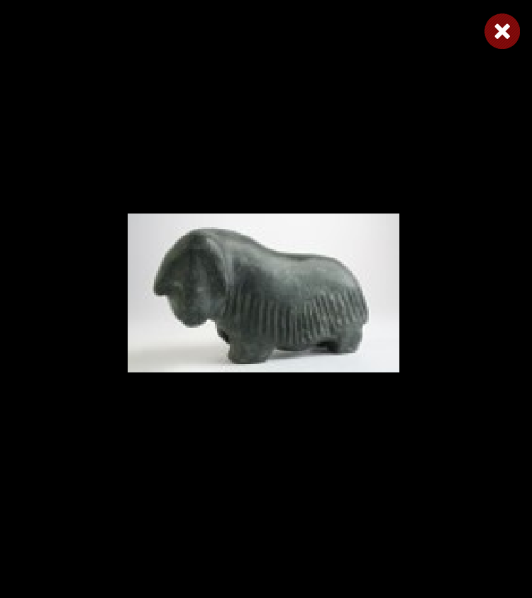
Bird Shaman
Shaman
Bird Spirits
Toonoo Sharky, b. 1970
gk }nr
Barnabus A.
Toonoo Sharky
Shaman
Steatite
Birds
Stone
Bird Shaman
Musk Ox
Toonoo Sharky
Barnabus A.
Birds
Stone
Ox
Stone
Amauti Dress
Preparing to Fly
Talerook, M.
Toonoo Sharky
Amauti
Fabric
Birds
Stone
Musk Ox
Arviat
1995, Stone Cape Dorset, Cape Dorset Gift of Dr. Harry Winrob, 2006-516
Lucassie I.
Anowtalik, L.
Ox
Antler
Antler

Slide 87
Bird Shaman
Shaman
Bird Spirits
Toonoo Sharky, b. 1970
gk }nr
Barnabus A.
Toonoo Sharky
Shaman
Steatite
Birds
Stone
Bird Shaman
Musk Ox
Toonoo Sharky
Barnabus A.
Birds
Stone
Ox
Stone
Amauti Dress
Preparing to Fly
Talerook, M.
Toonoo Sharky
Amauti
Fabric
Birds
Stone
Musk Ox
Arviat
1995, Stone Cape Dorset, Cape Dorset Gift of Dr. Harry Winrob, 2006-516
Lucassie I.
Anowtalik, L.
Ox
Antler
Antler

Slide 88
Bird Shaman
Shaman
Bird Spirits
Toonoo Sharky, b. 1970
gk }nr
Barnabus A.
Toonoo Sharky
Shaman
Steatite
Birds
Stone
Bird Shaman
Musk Ox
Toonoo Sharky
Barnabus A.
Birds
Stone
Ox
Stone
Amauti Dress
Preparing to Fly
Talerook, M.
Toonoo Sharky
Amauti
Fabric
Birds
Stone
Musk Ox
Arviat
1995, Stone Cape Dorset, Cape Dorset Gift of Dr. Harry Winrob, 2006-516
Lucassie I.
Anowtalik, L.
Ox
Antler
Antler

Slide 89
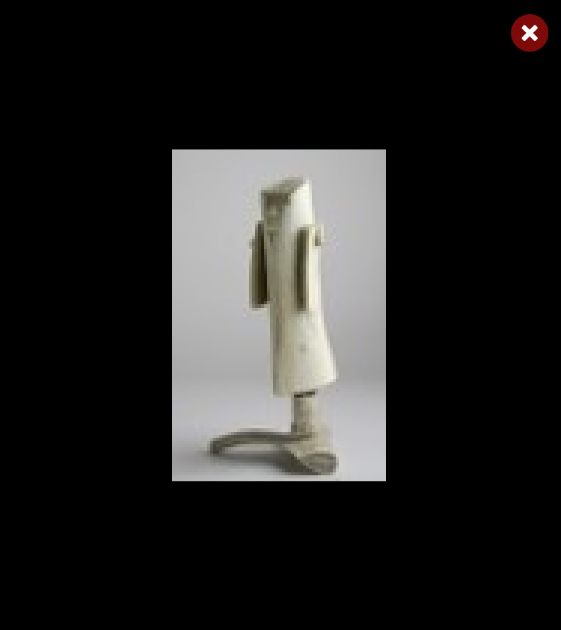
Bird Shaman
Shaman
Bird Spirits
Toonoo Sharky, b. 1970
gk }nr
Barnabus A.
Toonoo Sharky
Shaman
Steatite
Birds
Stone
Bird Shaman
Musk Ox
Toonoo Sharky
Barnabus A.
Birds
Stone
Ox
Stone
Amauti Dress
Preparing to Fly
Talerook, M.
Toonoo Sharky
Amauti
Fabric
Birds
Stone
Musk Ox
Arviat
1995, Stone Cape Dorset, Cape Dorset Gift of Dr. Harry Winrob, 2006-516
Lucassie I.
Anowtalik, L.
Ox
Antler
Antler

Slide 90
Bird Shaman
Shaman
Bird Spirits
Toonoo Sharky, b. 1970
gk }nr
Barnabus A.
Toonoo Sharky
Shaman
Steatite
Birds
Stone
Bird Shaman
Musk Ox
Toonoo Sharky
Barnabus A.
Birds
Stone
Ox
Stone
Amauti Dress
Preparing to Fly
Talerook, M.
Toonoo Sharky
Amauti
Fabric
Birds
Stone
Musk Ox
Arviat
1995, Stone Cape Dorset, Cape Dorset Gift of Dr. Harry Winrob, 2006-516
Lucassie I.
Anowtalik, L.
Ox
Antler
Antler

Slide 91

Bird Shaman
Shaman
Bird Spirits
Toonoo Sharky, b. 1970
gk }nr
Barnabus A.
Toonoo Sharky
Shaman
Steatite
Birds
Stone
Bird Shaman
Musk Ox
Toonoo Sharky
Barnabus A.
Birds
Stone
Ox
Stone
Amauti Dress
Preparing to Fly
Talerook, M.
Toonoo Sharky
Amauti
Fabric
Birds
Stone
Musk Ox
Arviat
1995, Stone Cape Dorset, Cape Dorset Gift of Dr. Harry Winrob, 2006-516
Lucassie I.
Anowtalik, L.
Ox
Antler
Antler

Slide 92
Bird Shaman
Exhibition
Toonoo Sharky, b. 1970
gk }nr
1995, Stone Cape Dorset, Cape Dorset Gift of Dr. Harry Winrob, 2006-516

Slide 93
Bird Shaman
Toonoo Sharky, b. 1970
gk }nr
1995, Stone Cape Dorset, Cape Dorset Gift of Dr. Harry Winrob, 2006-516

